Slide 1
Presentation brief for MCT’s
Title of presentation | Ingest and load data into the data warehouse
Presentation\Lab length | Presentation: 50 - 60 minutes Lab: 50 – 60 minutes
Audience | Data Engineers, Data Scientists, Data Professionals, Data Architects, BI Professionals, Developers
Purpose | Understand the different ways that you can ingest and load data into a data warehouse Understand the best practices associated with ingesting and loading data Use the Copy Activity in Azure Data Factory/Azure Synapse Pipelines
(think) Student key takeaways | The student should know the difference between PolyBase, Copy and the Copy activity The student should be able to list 5 data loading best practices The student should understand how the Copy Activity can simplify the process of data ingestion
(feel) Student desired mindset | The student may feel that this is a complex area and not be familiar with all of the available options The student may feel that they need clarification of some of the data loading best practices you present
(do) Student outcomes | The student should be able to use the PolyBase and Copy statement The student should be able to implement at least three data loading best practices The students should be able to use the Copy Activity
More information | For MCT course feedback, visit the Microsoft Official Courseware forum
Notes:
Instructor notes.
This slide is for MCT use only, outlining the aims and objectives of this module.

Slide 2
DP-203T00: Ingest and load data into the data warehouse
Notes:
Instructor notes and guidance.
Data Ingestion is an extremely important part of data engineering that involves balancing the needs of source systems, ensuring that you do not disrupt them from their purpose, with the needs of loading the data into a data store that is part of an analytical system. Not only does this module show the students how they can ingest the data with a variety of techniques including PolyBase and the Copy command, but you will also find that you will be spending time sharing with the students the considerations that they must consider when ingesting and loading data. To that end, you will teach the students the common best practices that we have observed with customers. It is quite possible that slide 4 is one of the longest slides that you will teach given the breadth of content, but the notes will prepare you well to answer any questions that you will face in this area.
With that understood, the second part of the module explore a simple way you can ingest data without writing code. Here you will explore the Copy Activity that is available in both Azure Data Factory and Azure Synapse Pipelines. The students will make use of this in exercise two of the lab, so it will be better to allow them to get their hands on it rather then spending too much time teaching it.

Slide 3

Agenda
Lesson 01: Use data loading best practices in Azure Synapse Analytics
Lesson 02: Petabyte-scale ingestion with Azure Data Factory
Notes:
Instructor notes and guidance.
This space has been left deliberately blank

Slide 4
Lesson 01: Use data loading best practices in Azure Synapse Analytics
Notes:
Instructor notes
This space has been left deliberately blank

Slide 5

Dedicated SQL Pool architecture revision
Compute Node
Compute Node
Compute Node
0110101010101010101101010111010101010110
0110101010101010101101010111010101010110
0110101010101010101101010111010101010110
Compute Node
Compute Node
Compute Node
0110101010101010101101010111010101010110
0110101010101010101101010111010101010110
0110101010101010101101010111010101010110
Control Node
Notes:
Talking points
When you use Synapse SQL, your analytics workload runs using a SQL pool. In a SQL pool, the Control and Compute nodes in the cluster run a version of Azure SQL Database that supports distributed queries. You define your logic using Transact-SQL statements. You send your Transact-SQL statements to the control node, which splits up the work into queries that operate over a subset of the data, and then sends these smaller queries to the compute nodes. The data is split into chunks called distributions. A distribution is the basic unit of storage and processing for parallel queries that run on distributed data. Each of the smaller queries runs on one of the data distributions.
Instructor notes and guidance.
The data warehouse architecture in Azure Synapse Analytics is built around the core fundamentals of Massively Parallel Processing (MPP) and is covered in DP-900 data fundamentals, In this build slide there are two clicks:
<Click 1>
A control node takes ownership of query orchestration.
<Click 2>
When a query is submitted to the data warehouse, the query is pushed down for processing to each of the compute nodes.
Note, when you understand how this compute can now execute querying in parallel, we’ll dive into the best practices of loading data.
Recommended reading for this slide
https://docs.microsoft.com/en-us/learn/paths/azure-data-fundamentals-explore-data-warehouse-analytics/

Slide 6
Understand data load design goals
Where is my data coming from?
Is the data nett new? or do you receive changes from existing datasets?
How often is the data being refreshed, added to or replaced?
What formats are the data coming in?
Is the data ingestible as-is? or are transformations and cleansing tasks required?
Which takes priority, loading or querying/analysis?
Notes:
Talking points
Loading data is essential because of the need to query or analyze the data to gain insights from it, so one of the main design goals in loading data, is to manage or minimize the impact on analytical workloads while loading the data with the highest throughput possible. Some of the questions that need to be asked when considering data loading are included in the slide.
Instructor notes and guidance.
Consider asking the students what they think are additional considerations that they have taken into account when looking at data load design goals
Recommended reading for this slide
https://docs.microsoft.com/en-us/learn/modules/use-data-loading-best-practices-azure-synapse-analytics/2-understand-design-goals

Slide 7



Manage singleton updates
Compute Node
Compute Node
Compute Node
0110101010101010101101010111010101010110
0110101010101010101101010111010101010110
0110101010101010101101010111010101010110
Compute Node
Compute Node
Compute Node
0110101010101010101101010111010101010110
0110101010101010101101010111010101010110
0110101010101010101101010111010101010110
Control Node
Notes:
Talking points
If you have thousands or more single inserts throughout the day, batch the inserts so you can bulk load them. Develop your processes to append the single inserts to a file, and then create another process that periodically loads the file.
Instructor notes and guidance.
This is a build slide that shows a singleton insert moves through the control node, then to the allocated to a specific compute node. Singleton loads, or small transaction loads create unnecessary flow of data. The goal is to group the append the singleton insert to files and use a faster load option by “batch importing"
Recommended reading for this slide
https://docs.microsoft.com/en-us/azure/sql-data-warehouse/guidance-for-loading-data#inserting-data-into-a-production-table
https://docs.microsoft.com/en-us/learn/modules/use-data-loading-best-practices-azure-synapse-analytics/5-manage-singleton-updates

Slide 8


Set-up dedicated data loading accounts
Compute Node
Compute Node
Compute Node
0110101010101010101101010111010101010110
0110101010101010101101010111010101010110
0110101010101010101101010111010101010110
Compute Node
Compute Node
Compute Node
0110101010101010101101010111010101010110
0110101010101010101101010111010101010110
0110101010101010101101010111010101010110
Control Node
Notes:
Talking points
In order to optimize for faster load speeds, and assign data loads to designated resource classes, it is recommended to create a dedicated load user account. Create loading users designated for running loads. Assign each loading user to a specific resource class. This method is simpler than trying to change a user's resource class to fit the current resource class need.
Instructor notes and guidance.
Use an example to create a login in the dedicated SQL pool. For example:
CREATE LOGIN loader WITH PASSWORD = 'a123STRONGpassword!';
Recommended reading for this slide
https://docs.microsoft.com/en-us/azure/sql-data-warehouse/guidance-for-loading-data#allowing-multiple-users-to-load
https://docs.microsoft.com/en-us/learn/modules/use-data-loading-best-practices-azure-synapse-analytics/6-set-up-dedicated-accounts

Slide 9

Manage concurrent access to Azure Synapse Analytics
Compute Node
Compute Node
Compute Node
0110101010101010101101010111010101010110
0110101010101010101101010111010101010110
0110101010101010101101010111010101010110
Compute Node
Compute Node
Compute Node
0110101010101010101101010111010101010110
0110101010101010101101010111010101010110
0110101010101010101101010111010101010110
Control Node
Notes:
Talking points
In order to optimize load speeds, it is important to reducing the amount of concurrent access. This can be accomplished by either running one load job, running a minimal amount of concurrent load jobs, or making use of workload group management to prioritize workloads running against a dedicated SQL pool
Instructor notes and guidance.
There are several ways this could be managed. You can take a profile of the data activity that takes place in the service and choose a time to load the data. You could include a process that kicks users of the system before performing a data load. You can also make use of workload group management that is covered in the next slide
Recommended reading for this slide
https://docs.microsoft.com/en-us/azure/sql-data-warehouse/guidance-for-loading-data#running-loads-with-enough-compute
https://docs.microsoft.com/en-us/learn/modules/use-data-loading-best-practices-azure-synapse-analytics/7-manage-concurrent-access

Slide 10

Implement Workload Management
Compute Node
Compute Node
Compute Node
0110101010101010101101010111010101010110
0110101010101010101101010111010101010110
0110101010101010101101010111010101010110
Compute Node
Compute Node
Compute Node
0110101010101010101101010111010101010110
0110101010101010101101010111010101010110
0110101010101010101101010111010101010110
Control Node
Notes:
Talking points
Azure Synapse Analytics allows you to create, control, and manage resource availability when workloads are competing. This allows you to manage the relative importance of each workload when waiting for available resources.
To facilitate faster load times, you can create a workload classifier for the load user with the “importance” set to above_normal or High. Workload importance ensures that the load takes precedence over other waiting tasks of a lower importance rating. Use this in conjunction with your own workload group definitions for workload isolation to manage minimum and maximum resource allocations during peak and quiet periods.
Instructor notes and guidance.
Its important to make the distinction between
- Workload classification
- Workload importance
- Workload isolation
When going through this topic and ensure the students understand the difference
Recommended reading for this slide
https://docs.microsoft.com/en-us/learn/modules/use-data-loading-best-practices-azure-synapse-analytics/8-implement-workload-management
https://docs.microsoft.com/en-us/learn/modules/use-data-loading-best-practices-azure-synapse-analytics/9-exercise-implement-workload-management

Slide 11
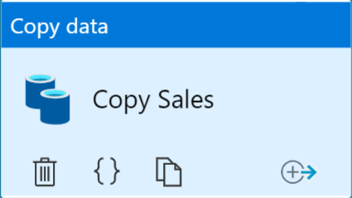


Use PolyBase, the Copy command or the Copy Activity
PolyBase
Copy command
Copy data activity
Staging Tables
Production Tables
Notes:
Talking points
There are multiple methods to transferring data into tables in a dedicated SQL pool. PolyBase is an established method for transferring data from files stored in a data lake into table in a dedicated SQL pool and is a method that can also work with serverless SQL pools. Recently the copy command has been introduced to simplify the process of transferring data and can be quicker in some instances. For ingesting data using a GUI method, the copy data activity in Azure Data Factory/Synapse pipelines
Instructor notes and guidance.
With the low volumes of data in the course, it is difficult to extrapolate the performance difference between the three methods. Remind students that they would have used Polybase in module 2, and that they will explore the copy command and the copy data activity in this lab
Recommended reading for this slide

Slide 12
Lesson 02: Petabyte-scale ingestion with Azure Data Factory
Notes:
Instructor notes
This space has been left deliberately blank

Slide 13







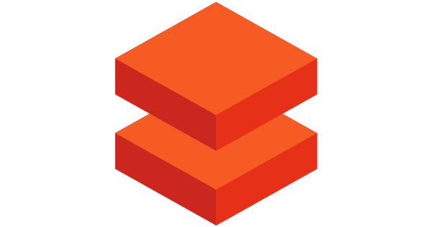
Azure Data Factory/Synapse pipeline revision
@
Triggers
Parameters
Linked Service
IR
Integration
Runtime
CF
Control
Flow
Pipeline
Data Lake Store
1
Activities
Azure Databricks
Dataset
Notes:
Talking points
Let’s have a reminder of the components of Azure Data Factory/Azure Synapse pipelines
Linked services
Linked services are much like connection strings, which define the connection information that's needed for Data Factory to connect to external resources. Think of it this way: a linked service defines the connection to the data source, and a dataset represents the structure of the data. For example, an Azure Storage-linked service specifies a connection string to connect to the Azure Storage account. Additionally, an Azure blob dataset specifies the blob container and the folder that contains the data.
Linked services are used for two purposes in Data Factory:
To represent a data store that includes, but isn't limited to, an on-premises SQL Server database, Oracle database, file share, or Azure blob storage account. For a list of supported data stores, see the copy activity article.
To represent a compute resource that can host the execution of an activity. For example, the HDInsightHive activity runs on an HDInsight Hadoop cluster. For a list of transformation activities and supported compute environments, see the transform data article.
Datasets
Datasets represent data structures within the data stores, which simply point to or reference the data you want to use in your activities as inputs or outputs.
Activity
Activities represent a processing step in a pipeline. For example, you might use a copy activity to copy data from one data store to another data store. Similarly, you might use a Hive activity, which runs a Hive query on an Azure HDInsight cluster, to transform or analyze your data. Data Factory supports three types of activities: data movement activities, data transformation activities, and control activities.
Pipeline
A data factory might have one or more pipelines. A pipeline is a logical grouping of activities that performs a unit of work. Together, the activities in a pipeline perform a task. For example, a pipeline can contain a group of activities that ingests data from an Azure blob, and then runs a Hive query on an HDInsight cluster to partition the data.
The benefit of this is that the pipeline allows you to manage the activities as a set instead of managing each one individually. The activities in a pipeline can be chained together to operate sequentially, or they can operate independently in parallel.
Triggers
Triggers represent the unit of processing that determines when a pipeline execution needs to be kicked off. There are different types of triggers for different types of events.
Pipeline runs
A pipeline run is an instance of the pipeline execution. Pipeline runs are typically instantiated by passing the arguments to the parameters that are defined in pipelines. The arguments can be passed manually or within the trigger definition.
Parameters
Parameters are key-value pairs of read-only configuration. Parameters are defined in the pipeline. The arguments for the defined parameters are passed during execution from the run context that was created by a trigger or a pipeline that was executed manually. Activities within the pipeline consume the parameter values.
A dataset is a strongly typed parameter and a reusable/referenceable entity. An activity can reference datasets and can consume the properties that are defined in the dataset definition.
A linked service is also a strongly typed parameter that contains the connection information to either a data store or a compute environment. It is also a reusable/referenceable entity.
Control flow
Control flow is an orchestration of pipeline activities that includes chaining activities in a sequence, branching, defining parameters at the pipeline level, and passing arguments while invoking the pipeline on-demand or from a trigger. It also includes custom-state passing and looping containers, that is, For-each iterators.
Variables
Variables can be used inside of pipelines to store temporary values and can also be used in conjunction with parameters to enable passing values between pipelines, data flows, and other activities.
Instructor notes and guidance.
This is a build slide that enables you to talk in depth about each object. Below is a summary of the clicks, to indicate what you can talk about at each click:
Click 1 – Enable you to speak about Linked Services:
Click 2 – Use Data Lake Store as a storage resource example
Click 3 – Use Databricks as a compute resource example
Click 4 – Enables you to talk about the Dataset object
Click 5 – this is a graphic to show a flow of data
Click 6 – Bring up the word activity
Click 7 – shows a rotating cog to reflect a single activity
Click 8 – removes the word activity
Click 9 - shows multiple rotating cogs to reflect multiple activities
Click 10 – Shows a funnel with the word pipeline to show that activities are grouped into a pipeline.
Click 11 – The word trigger appears with a circular arrow
Click 12 – The circular arrow rotates to indicate that a pipeline is triggered to execute
Click 13 - nothing happens
Click 14 – a number 1 appears out of the data and flows through the pipeline into the data set to reflect data being transformed by the activities in a pipeline
Click 15 - The word Parameters with an @ symbol appears
Click 16 – The word Integration runtime appears with an IR icon
Click 17 - The word Control Flow appears with the CF icon
Recommended reading for this slide
https://docs.microsoft.com/en-us/learn/modules/data-integration-azure-data-factory/5-understand-components

Slide 14
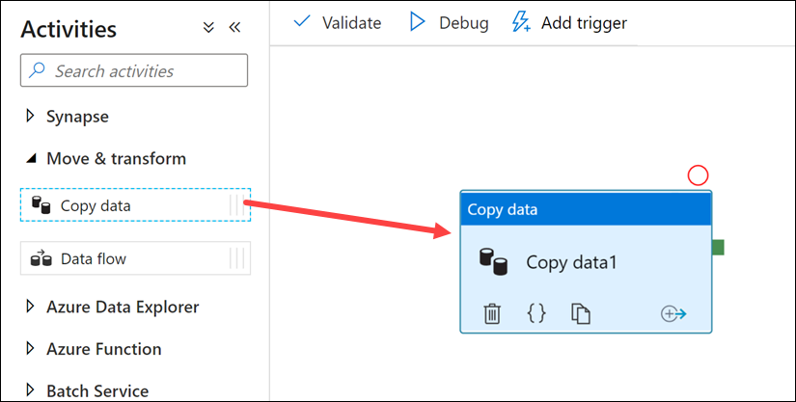
Petabyte-scale ingestion with Azure Data Factory
Notes:
Talking points
Use this method to build code-free data ingestion pipelines that don’t require any transformation during the extraction of the data. The Copy Activity has support for over 100 native connectors. This method can suit new start-up projects that have a simple method of extraction to an intermediary data store. An example of ingesting data using the Copy Activity can include extracting data from multiple source database systems and outputting the data to files in a data lake store.
The Copy activity performs the following steps:
Reads data from a source data store.
Performs serialization/deserialization, compression/decompression, column mapping, and so on. It performs these operations based on the configuration of the input dataset, output dataset, and Copy activity.
Writes data to the sink/destination data store
Instructor notes and guidance.
You may want to consider running a simple demo of the copy activity yourself to show how to setup the copy activity in Azure Data Factory/Azure Synapse pipelines. Inform the students that they will get to explore the Copy Activity in exercise 2 of the lab.
Recommended reading for this slide
Use data loading best practices in Azure Synapse Analytics - Learn | Microsoft Docs

Slide 15
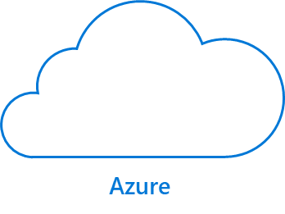
Understanding integration
IR
IR
SQL Server
Azure Integration
Runtime
Self-hosted
Integration Runtime
Notes:
Talking points
The Copy activity is executed on an integration runtime.
Different types of integration runtimes for different data copy scenarios:
When you're copying data between two data stores that are publicly accessible through the internet from any IP, you can use the Azure integration runtime for the copy activity. This integration runtime is secure, reliable, scalable, and globally available.
When you're copying data to and from data stores that are located on-premises or in a network with access control (for example, an Azure virtual network), you need to set up a self-hosted integration runtime.
An integration runtime needs to be associated with each source and sink data store.
Instructor notes and guidance.
You may want to consider running a simple demo of the copy activity yourself to show how to setup the copy activity in Azure Data Factory/Azure Synapse pipelines. Inform the students that they will get to explore the Copy Activity in exercise 2 of the lab.
Recommended reading for this slide
https://docs.microsoft.com/en-us/learn/modules/petabyte-scale-ingestion-azure-data-factory/5-manage-self-hosted-integration-runtime
https://docs.microsoft.com/en-us/learn/modules/petabyte-scale-ingestion-azure-data-factory/6-set-up-azure-integration-runtime
Refresh yourself with an overview of Azure Data Factory with the following link:
https://docs.microsoft.com/en-us/azure/data-factory/concepts-integration-runtime
For information about how the Copy activity determines which integration runtime to use, see
https://docs.microsoft.com/en-us/azure/data-factory/concepts-integration-runtime#determining-which-ir-to-use

Slide 16
Review questions
Q01 – Which data loading feature limits the number of resources a group of requests can consume in Azure Synapse Analytics?
A01 – Workload management
Q02 – Why should you split up one large files into smaller files when loading data into a dedicated SQL pool in Azure Synapse Analytics?
A02 – To take advantage of the Massively Parallel Processing (MPP) architecture
Q03 – In which section of the Data Factory designer canvass would you find the Copy Activity?
A03 – Move and Transform
Notes:
Instructor notes and guidance.
This space has been left deliberately blank

Slide 17
Lab: Ingest and load data into the data warehouse
Notes:
Instructor notes and guidance.
This space has been left deliberately blank

Slide 18
Lab overview
This lab teaches students how to ingest data into the data warehouse through T-SQL scripts and Synapse Analytics integration pipelines. The student will learn how to load data into Synapse dedicated SQL pools with PolyBase and COPY using T-SQL. The student will also learn how to use workload management along with a Copy activity in a Azure Synapse pipeline for petabyte-scale data ingestion.
Lab objectives
After completing this lab, you will be able to:
Use data loading best practices in Azure Synapse Analytics
Petabyte-scale ingestion with Azure Data Factory
Notes:
Instructor notes and guidance.
In exercise one, you will explore loading data by using Transact-SQL statements, and deliberately compare PolyBase and the Copy command so that the student get to see for themselves which method they would like to use. Code is provided in the lab, but you may want to take students who are less familiar with T-SQL through the code, so they understand how it work. Exercise 2 begins by exploring the data loading best practice of working with workload management so that you can manage the priority of a data load. They then move onto the Copy Activity to simplify data ingestion, and deep dive into the settings that are required to set this up successfully.

Slide 19


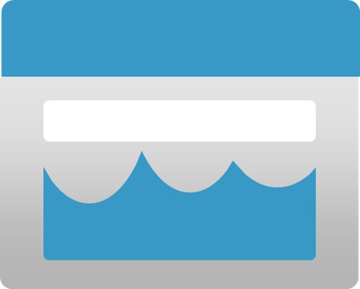








Lab 07 Overview
asacosmosdb<unique_suffix>
CosmosDB
Campaign Info
Azure Databricks
asagadatalake<unique_suffix>
Cluster
Azure Data Lake
wwi-02
Sales (parquet)
Customer (csv)
dp203sql<unique_suffix>
SourceDB
Synapse Analytics
Dedicated SQL Pool (SQLPool1)
Built-In Serverless SQL Pool
Apache Spark pool
Pipelines and Dataflows
Power BI
asagaworkspace<unique_suffix>
Notes:
This slide is an optional slide that you can use to show a high-level overview of the technologies used in the lab.
This lab teaches students how to ingest data into the data warehouse through T-SQL scripts and Synapse Analytics integration pipelines. The student will learn how to load data into Synapse dedicated SQL pools with PolyBase and COPY using T-SQL. The student will also learn how to use workload management along with a Copy activity in a Azure Synapse pipeline for petabyte-scale data ingestion.

Slide 20
Lab review
Question 1 – What is the appropriate distribution to use in a staging table?
Question 2 – When creating an External Data Source, what should the Type property be set to access data in a data lake?
Question 3 – When setting file format properties for a data source in the Copy Activity, you can import the schema from a connection/store and what other option?
Question 4 – You want to truncate a staging table before loading it with data in a Copy activity. Which sink property would you set to do this?
Notes:
Answers
Question 1 - DISTRIBUTION = ROUND_ROBIN is the best distribution to use for staging tables as it is the most efficient distribution for loading data
Question 2 – TYPE = HADOOP is the property that should be set in the External Data Source to access data in a data lake
Question 3 – The other option is sample file. This is a useful option to use when the source connection is very big. On big tables, to import the schema from it will take time, by having a sample file which only contains a smaller data set will resolve the schema much quicker.
Question 4 – The sink property to truncate a staging table before loading it with data in a Copy activity is the Pre-copy script property

Slide 21
Module summary
In this module, you have learned about:
Use data loading best practices in Azure Synapse Analytics
Petabyte-scale ingestion with Azure Data Factory
Next steps
After the course, consider reading [Best practices for loading data using dedicated SQL pools in Azure Synapse Analytics] for more guidance on data ingestion and loading
Notes:
Instructor notes and guidance.
The next steps is suggested post course learning materials to reinforce what they have learned in the module.

Slide 22
Closing slide
Notes:
Instructor notes and guidance.
This space has been left deliberately blank

